Slide 1
Image Classification Using Deep Neural Networks
Prepared and presented by: Caroline Katba
Website: katba-caroline.com

Slide 2
Outline
What is Deep Learning?
What are Neural Networks?
Important Concepts and Terms
How can we build an Image Classifier?
Image Classification Example
Further uses of Image Classification
Q & A

Slide 3
Deep Learning: A subset of Machine Learning Algorithms that is very good at recognizing patterns but typically requires a large number of data.
source
Deep learning is an excellent way to develop a strong program that can recognize objects in images. it’s implemented using several layers of artificial neural networks where each layer is responsible for extracting one or more features of the image. It is the nature in which this network is built that lends it the name deep.

Slide 4
What are some of the practical applications on Deep Learning?
Beating humans in games like Go and Jeopardy
Detecting Stock Prices
Identifying Cancer Cells
Teams at UCLA built an advanced microscope that yields a high-dimensional data set used to train a deep learning application to accurately identify cancer cells.
Improving work place safety
by automatically detecting when people or objects are within an unsafe distance of machines.
Making automated self-driving cars a reality
By automatically detecting objects such as stop signs and traffic lights and pedestrians, which helps decrease accidents.
Read more here: source

Slide 5
Neural Networks: The Heart (or Brain) of Deep Learning
Neural networks are called that because they vaguely imitate the brain operations, where many nodes are connected to one another and firing off information to make a decision.
The term “deep” usually refers to the number of hidden layers in the neural network. Traditional neural networks only contain 2-3 hidden layers, while deep networks can have as many as 150. source

Slide 6
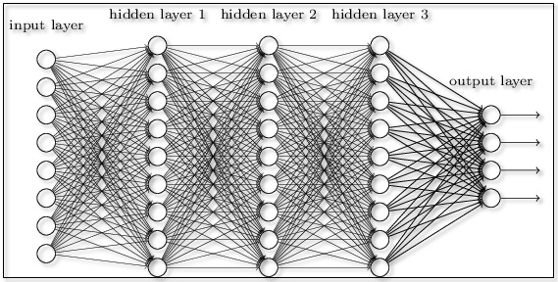
Here is what a Neural Network could look like:

Slide 7

Here’s what it’s actually doing:
Notes:
Think of it like a child drawing a line between two sets of points

Slide 8
Important Concepts and Terms
A very brief introduction to the nuts and bolts of a Neural Network:
Perceptron
Sigmoid Function
Softmax Function
Cross-Entropy
Feedforward
Backpropagation
Notes:
No equations, I promise

Slide 9
Perceptron: Building Block of Neural Networks
A perceptron takes several binary inputs, and produces a single binary output.
To compute output, simply use Weights
Weights are real numbers that express the importance of each input relative to the output.
The neuron's output, 0 or 1, is determined by whether the weighted sum is less than or greater than some threshold value.
Concern: any small tweak to our neural network could completely throw off our entire model and could change the output from 0 to 1 or vice versa.
Read more here: source
Notes:
Concern: think if a neural network is classifying a 9 instead of an 8 for an 8

Slide 10
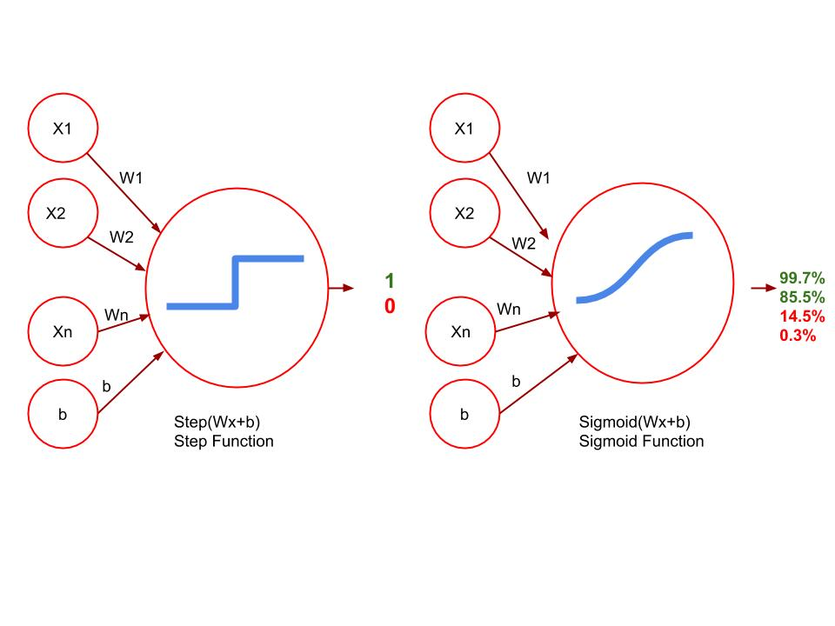
Sigmoid Smooth is the way to go
Now our predictions are a probability rather than a 1 or 0.
Continuous predictions rather than Discrete.
Notes:
In order for us to use gradient descent we need a continuous error function. Using gradient descent to minimize our errors, We can detect very small variation in errors and figure what direction we can decrease the most.

Slide 11
Softmax: activation function for more than 2 classes
Softmax is the equivalent of the sigmoid activation function, but for when we have a multiclass classification problem.
“Softmax computes the exponential (e-power) of the given input value and the sum of exponential values of all the values in the inputs. Then the ratio of the exponential of the input value and the sum of exponential values is the output of the softmax function.”
Main Softmax advantage: output probabilities range.
The range is 0 to 1, and the sum of all the probabilities will always equal to one.
No negative probabilities
In multi-classification models, softmax returns the probabilities of each class and the target class will have the high probability.
Read more here: source
Notes:
I tried not to put too many equations here, I promise

Slide 12
Cross Entropy
Cross Entropy looks at the likelihood that events happen based on the probabilities:
If very likely, then small Cross-Entropy
If very unlikely, then large Cross-Entropy
A good model will give us low cross-entropy, a bad model will give us high cross-entropy
In Machine Learning models: The cross-entropy compares the model’s prediction with the label which is the true probability distribution.
The cross-entropy goes down as the prediction gets more and more accurate.
It becomes zero if the prediction is perfect.
Therefore, the cross-entropy can be a loss function to train a classification model.
Read more here: source
Notes:
The reason that low cross entropy is good, is because a good model gives us a high probability and the negative of the logarithm of a large number is a small number and vice versa.

Slide 13
Feedforward
Not all models are linear, Neural Networks are excellent at solving classification problems that cannot be solved by drawing a straight line.
Feedforward is simply the process neural networks use to turn the input into an output.
Feedforward is what neural networks do:
They take the input vector
Apply a sequence of linear models and sigmoid functions
Then when combined, become highly non-linear map.

Slide 14
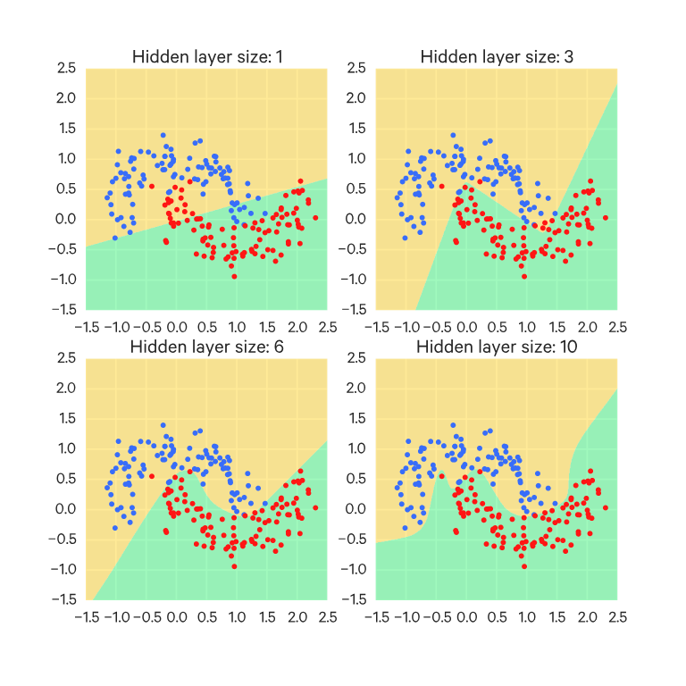
Example of Feedforward on non linear problems.

Slide 15
Backpropagation
Backpropagation consists of the following steps:
Doing a feedforward operation.
Comparing the output of the model with the desired output.
Calculating the error. (how bad was a point misclassified?)
Running the feedforward operation backwards (backpropagation) to spread the error to each of the weights.
Use this to update the weights, and get a better model.
Continue this until we have a model that is good.

Slide 16
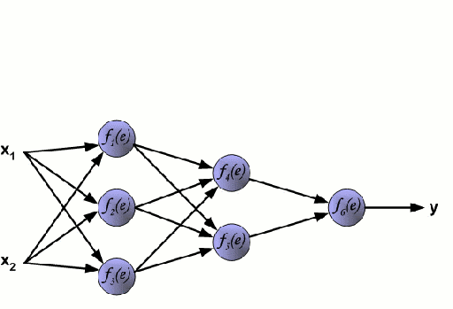
Example of backpropagation

Slide 17
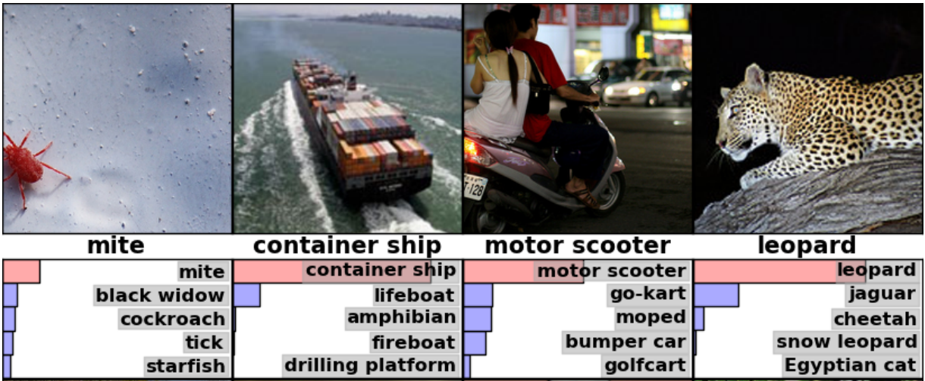
Image Classification
Teaching a child the difference between a lion and leopard is not hard, teaching a computer that difference is another story.
Using Neural Networks, we can train models to recognize objects in images accurately and consistently.
source

Slide 18

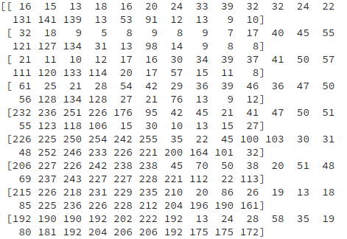
Human Vision vs. Computer Vision
For a computer, an image is nothing but a bunch of numbers arranged in a grid-like structure which is formally known as an Array.
source

Slide 19
How does a computer know what a cat looks like? Similarity Checks
We know what a cat looks like because we have see one before.
For computers, we can use an image of a cat’s face as an example image.
Or we can use the pixel values in the middle of the array.
To measure similarity between the picture use Frobenius Inner product:
“Frobenius Inner product is nothing but the element-wise multiplication of two arrays followed by the addition operation.
In general, it is one of the ways through which you can measure the similarity between two things(matrices).
It is nothing but the generalized version of the dot product with only one difference: dot product is defined for vectors and inner product is defined for matrices.”
Read more here: source

Slide 20
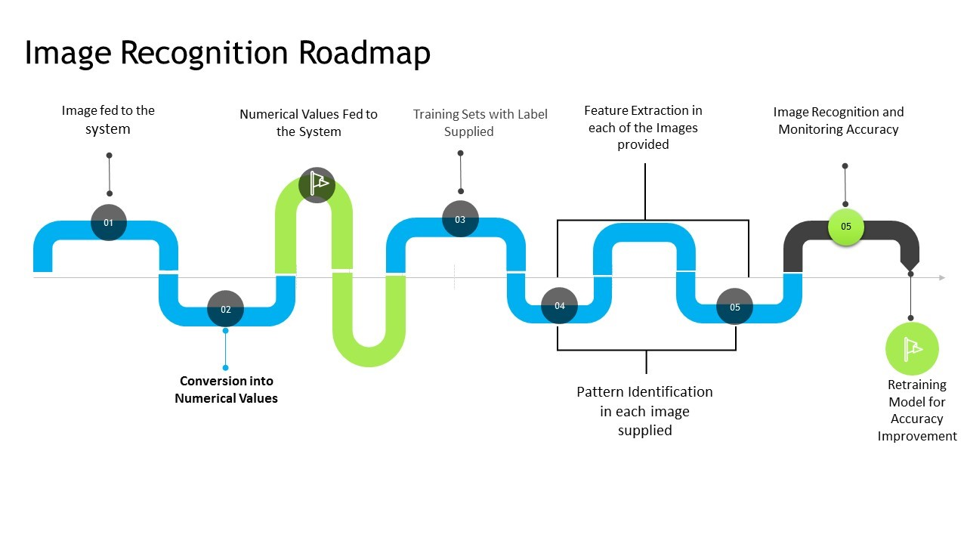
Image Classification Roadmap
source

Slide 21
Example: Flower Image Classifier
British flowers data set contains 102 categories of flowers with 40 to 258 images per class, you can read more about it here.
Using Pytorch (which is an optimized tensor library for deep learning using GPUs and CPUs), I built a deep learning model that utilizes transfer learning to build upon and improve a pre-designed neural network and achieve results with 80% accuracy.
This model is designed to provide accurate results as well as the probabilities of the top 5 predictions. Once you feed a new picture into the model, it automatically shows you the image with the flower’s name as the title, and produces a bar chart that shows the top 5 predicted classes.
Read more here: source

Slide 22
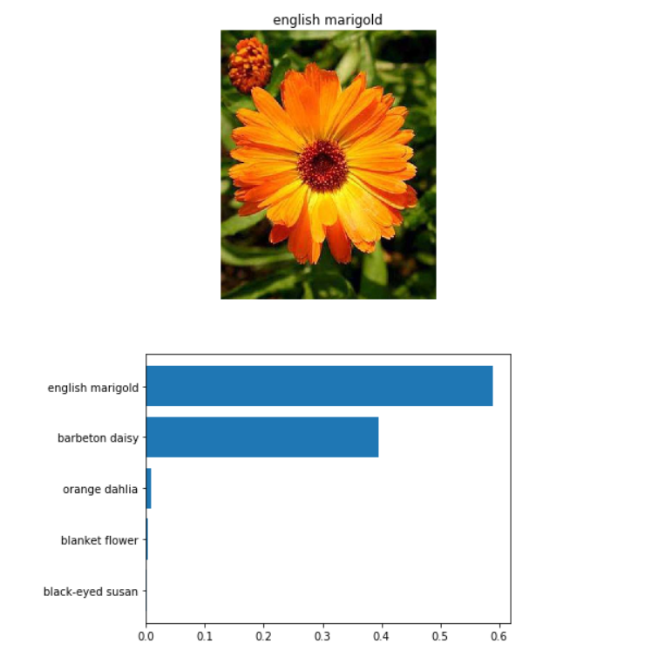
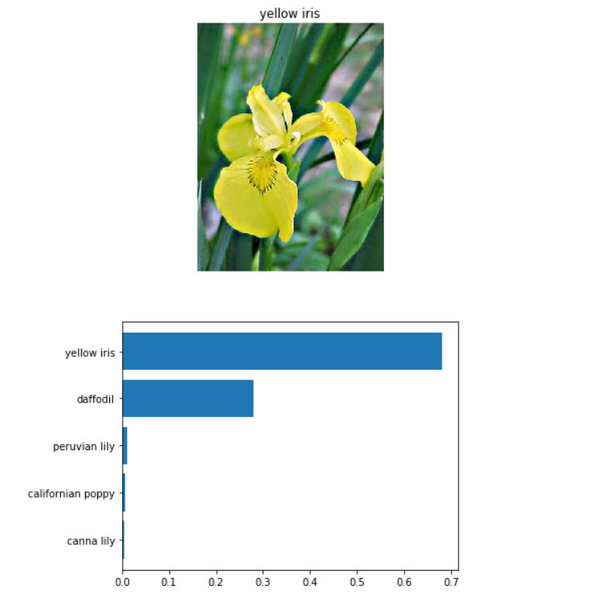
Example: Flower Image Classifier

Slide 23
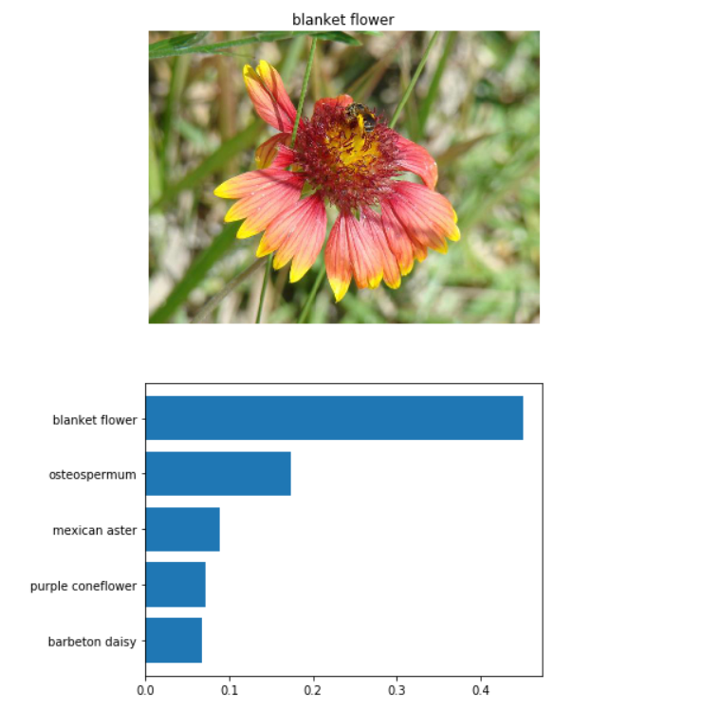
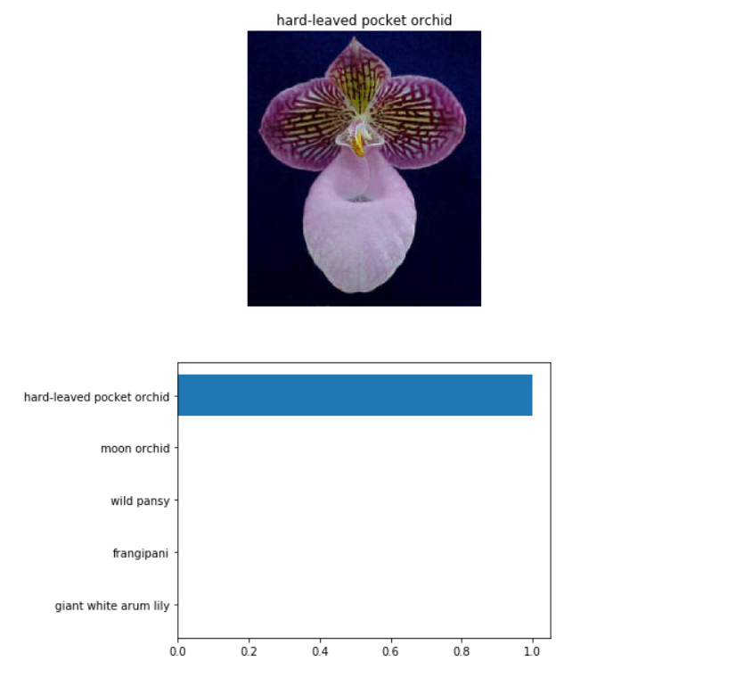
Example: Flower Image Classifier

Slide 24
Uses of Image Recognition
Facial recognition for more security or more surveillance.
Product identification for enhanced marketing and increased sales.
Drones can provide vision-based automatic monitoring, inspection, and control of assets located in remote areas.
Product line inspections: “evaluating critical points on a regular basis within the premises. Monitoring the quality of the final products to reduce the defects. Assessing the condition of the workers can help manufacturing industries to have a complete control of different activities in the systems.”
Autonomous vehicles with image recognition can identify activities on the road and take necessary actions. Mini robots can help logistics industries to locate and transfer the objects from one place to another. It also maintains the database of the product movement history to prevent the product from being misplaced or stolen.
Unmanned Aerial Vehicles can monitor the forest, predict changes that can result in forest fires, and prevent poaching. It can also provide a complete monitoring of the vast lands, which humans cannot access easily.”
Read more here: source

Slide 25
Thank you! Questions?
Caroline Katba
Webiste: https://katba-caroline.com/
Email: katba.caroline@gmail.com
Github: https://github.com/Katba-Caroline

